Slide 1
PONG
ELEC5620M Project Demonstrator
John Jakobsen (201291841)
Sam Wilcock (201285260)
Alexander Bolton (200938078)

Slide 2
Introduction
One of the earliest arcade games
Different varieties exist (singleplayer, multiplayer)
Displays the range of skills gained in the module
Uses VGA, LCD, buttons, HEX display, PS/2

Slide 3
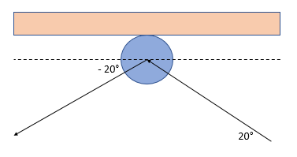
Physics
Collision checks are carried out in the
while loop
Border collisions invert the angle
Paddle collisions change the angle and
speed according to the collision location

Slide 4
Display Driver
320 x 240 pixels
Frame buffer made up of two types of arrays
Frame skip feature added
Functions added to the engine to ease use

Slide 5
Sprites & Text
Ball generated using Pythagoras’ theorem
Paddles created using Bresenham algorithm
Text made using a library of hex values

Slide 6
Game Engine
Sprite location recorded by global values
Sprites created and destroyed with commands in the game engine
Angle calculated using Bresenham algorithm

Slide 7
Menus
Three main types of screen
Menu contains blocking and non-blocking elements
Allows user to change audio, paddle size and game mode

Slide 8
Controls
Implementation of slider switches
Usage of interrupts
Macros created to aid functioning of inputs

Slide 9
Audio
Uses fast sin function
Values of sin(θ) calculated in Matlab and copied into a lookup table
Header file created containing musical notes

